Slide 1
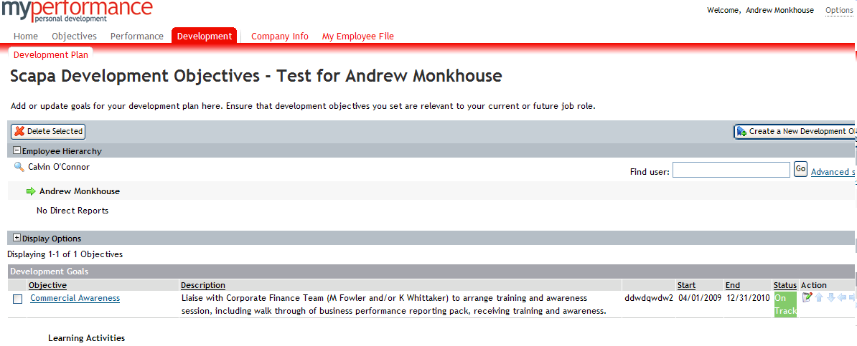
How to create a Development Objective
Click here to Create Development objectives

Slide 2
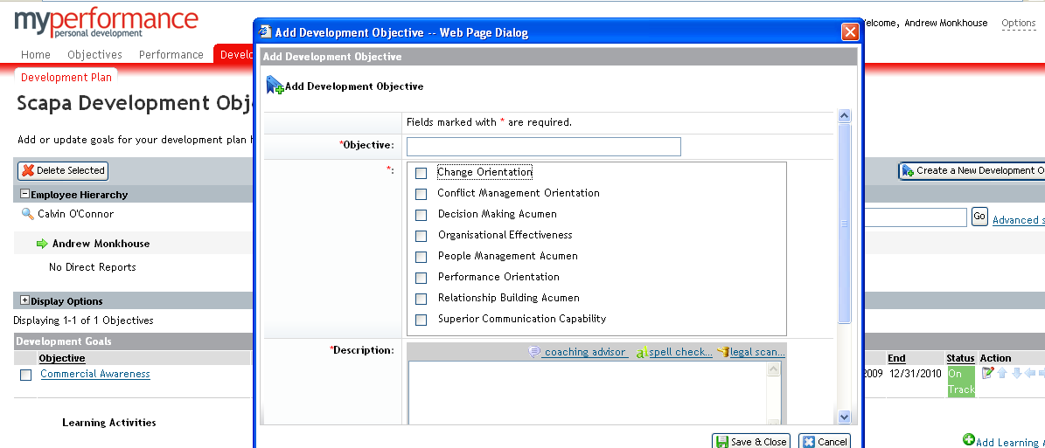
How to create a Development Objective
Click here to Legal Scan any wording
Click on icon for help in creating a development goal incorporating your 360 feedback

Slide 3
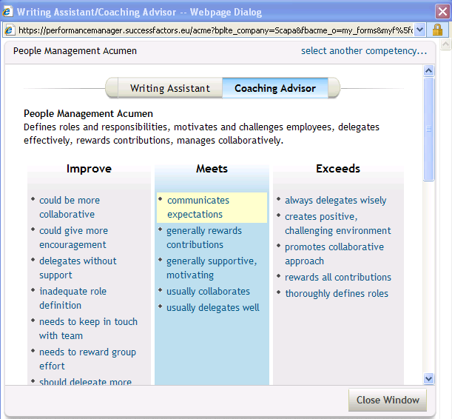
How to create a Development Objective - Coaching Advisor
Offers Mentoring and Development suggestions you can use for performance reviews/development feedback

Slide 4
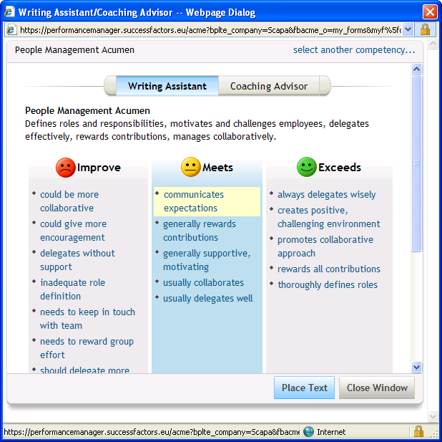
How to create a Development Objective – Writing Assistant
Provides sample text to help provide meaningful feedback about competencies
Remember to click and save
work at regular intervals

